Slide 1
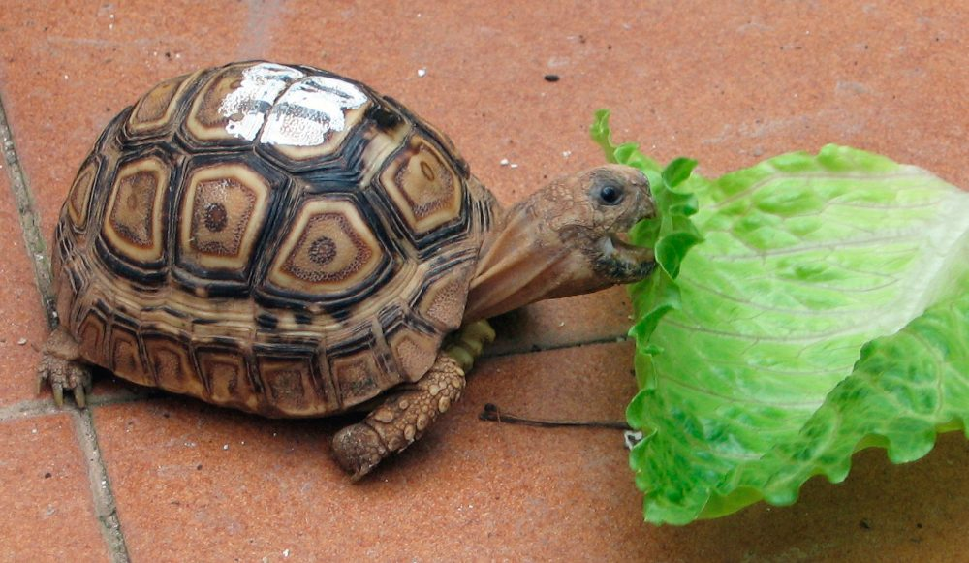
May month of the reptiles
turtles are reptiles that can reach more tan 100 years of life as the longest animal that may have . They feed on algae and other aquatic vegetation. they measure about 1.5 meters the largest turtle is about 3 meters and weigh around 200 kilos when theY are adults.

Slide 2
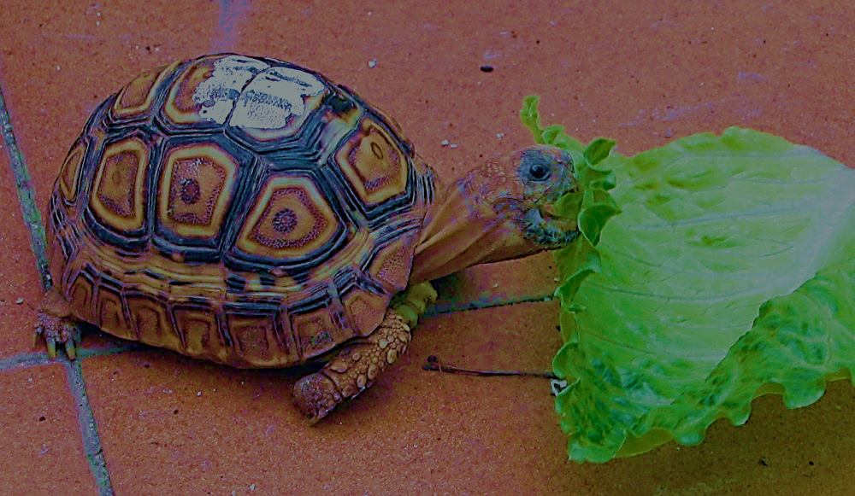
Month of May
Monday Lunes | Tuesday Martes | Wednesday Miercoles | Thursday Jueves | Fryday Viernes | Saturday Sábado | Sunday Domingo
 |  |  | 1 One | 2 Two | 3 Three | 4 Four
5 Five | 6 Six | 7 Seven | 8 Eigth | 9 Nine | 10 Ten | 11 Eleven
12 twelve | 13 thirteen | 14 fourteen | 15 fifteen | 16 sixteen | 17 seventeen | 18 eighteen
19 nineteen | 20 twenty | 21 Twenty-one | 22 twenty-two | 23 Twenty -three | 24 twenty four | 25 twenty-five
26 Twenty-six | 27 Twenty-seven | 28 Twenty- eigth | 29 twenty-nine | 30 trirty | 31 Trirty-one

